Slide 1
Random Forest

Slide 2
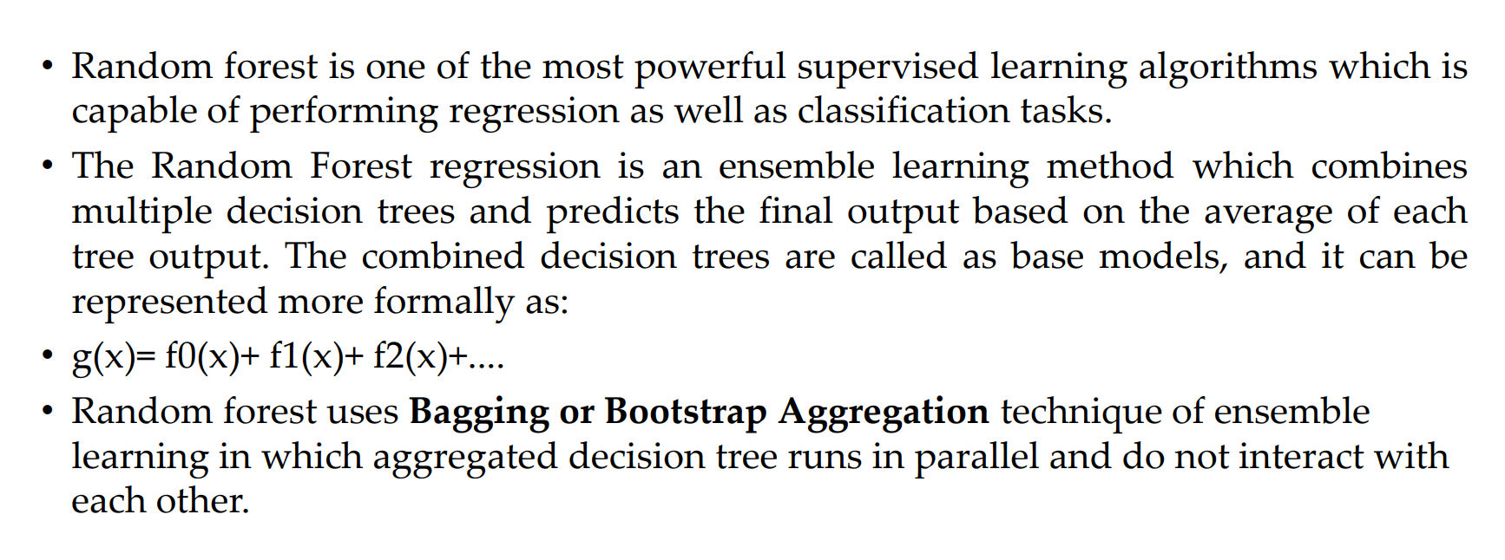

Slide 3
Ensemble learning is a machine learning technique that combines the predictions of multiple individual models to improve the overall performance and generalization ability of the system. Instead of relying on a single model, ensemble methods leverage the diversity of multiple models to make more accurate predictions.

Slide 4
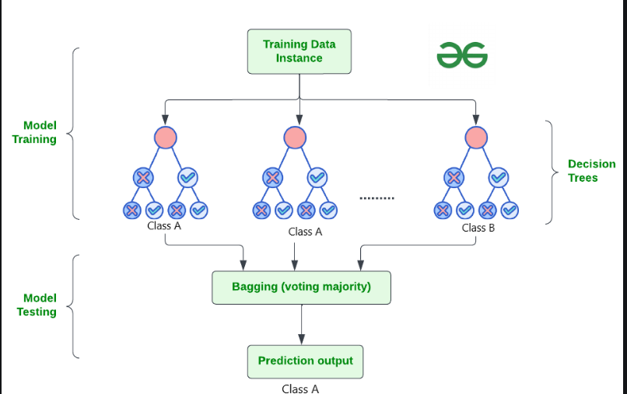

Slide 5
